Slide 1
操作系统概念
Operating System Concepts
Silberschatz, Galvin and Gagne
王冬青
wang.box@163.com

Slide 2
内容框架
概述
体系结构
进程管理
内存管理
文件管理
外设管理

Slide 3
内容
Ch4: 进程
Ch5: 线程
Ch6: CPU调度
Ch7：进程同步
Ch8：死锁

Slide 4
Ch 6: CPU Scheduling
Basic Concepts
Scheduling Criteria
Scheduling Algorithms
Multiple-Processor Scheduling
Real-Time Scheduling
Thread Scheduling
Algorithm Evaluation

Slide 5
Ch 6: CPU Scheduling
Basic Concepts
Scheduling Criteria
Scheduling Algorithms
Multiple-Processor Scheduling
Real-Time Scheduling
Thread Scheduling
Algorithm Evaluation

Slide 6
Basic Concepts
调度的背景及目的
进程工作方式
调度器 Scheduler
派遣器 Dispatcher

Slide 7
Basic Concepts
调度的背景及目的
进程工作方式
调度器 Scheduler
派遣器 Dispatcher

Slide 8
背景及目的
调度的背景
  多道或多任务系统
调度的目的
  最大化CPU利用率

Slide 9
Basic Concepts
调度的背景及目的
进程工作方式
调度器 Scheduler
派遣器 Dispatcher

Slide 10
进程工作方式
  进程的工作方式：
  CPU-I/O交替执行
    CPU Burst Cycle（执行周期）
    I/O Burst Cycle
  Process execution consists of a cycle of CPU execution and I/O wait.

Slide 11
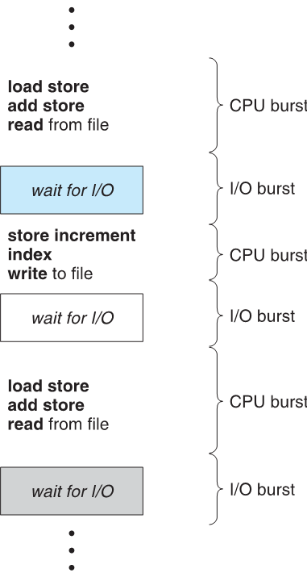
Alternating Sequence of CPU And I/O Bursts

Slide 12
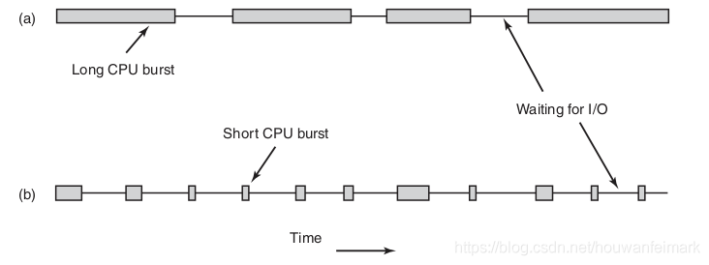
进程工作方式

Slide 13
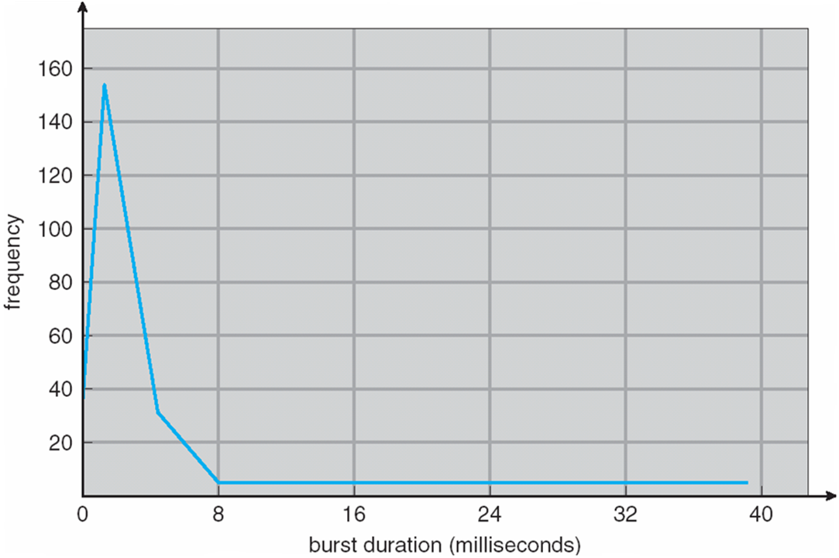
很多 短CPU区间
切换是频繁发生的
很少 长CPU区间
CPU区间长度频次分布图

Slide 14
Basic Concepts
调度的背景及目的
进程工作方式
调度器 Scheduler（CPU）
派遣器 Dispatcher

Slide 15

CPU Scheduler
CPU Scheduler(调度器)
  CPU scheduler selects a process from the ready processes and allocates the CPU to it.
短程调度

Slide 16
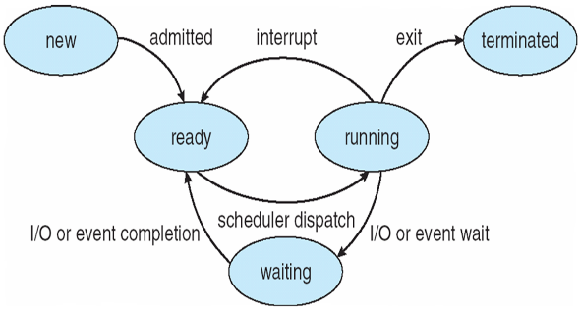
Preemptive-Scheduling
CPU scheduling decisions may take place when a process:
Scheduling under 1 and 2 only is non-preemptive(非抢占).
  Win 3.x，Apple Macintosh
Scheduling under all conditions is preemptive(抢占).
  Win 95之后, Linux，MacOS X之后
    Terminates.
    Switches from running to waiting state.
    Switches from running to ready state.
    Switches from waiting to ready.
    Switches from new to ready.
cooperation(协作、合作).

Slide 17
Basic Concepts
调度的背景及目的
进程工作方式
调度器 Scheduler
派遣器 Dispatcher

Slide 18
派遣器 Dispatcher
Dispatcher（派遣器）
  Dispatcher module gives control of the CPU to the process selected by the short-term scheduler;
  this involves:(工作流程)
    switching context (saving context and restoring context)
    switching to user mode (monitor mode → user mode)
    jumping to the proper location in the user program to restart that program(PC counter)
  Dispatch latency(分派延时) – time it takes for the dispatcher to stop one process and start another running.（越快越好）

Slide 19
Ch 6: CPU Scheduling
Basic Concepts
Scheduling Criteria
Scheduling Algorithms
Multiple-Processor Scheduling
Real-Time Scheduling
Thread Scheduling
Algorithm Evaluation

Slide 20
Scheduling Criteria
General Criteria
Optimization Criteria

Slide 21
Scheduling Criteria
General Criteria
  CPU utilization（使用率）
  keep the CPU as busy as possible
  Throughput（吞吐量）
  number of processes that complete their execution per time unit
系统角度

Slide 22
Scheduling Criteria
General Criteria
  Turnaround time（周转时间）
  amount of time to execute a particular process
  从等待进入内存到进程结束
  Waiting time（等待时间）
  amount of time a process has been waiting in the ready queue （就绪队列中等待时间总和）
  Response time （响应时间）
  amount of time it takes from when a request was submitted until the first response is produced, not output (for time-sharing environment)
用户角度

Slide 23
Scheduling Criteria
Optimization Criteria
  Max CPU utilization
  Max throughput
  Min turnaround time
  Min waiting time
  Min response time
本书标准：最小化平均等待时间

Slide 24
Ch 6: CPU Scheduling
Basic Concepts
Scheduling Criteria
Scheduling Algorithms
Multiple-Processor Scheduling
Real-Time Scheduling
Thread Scheduling
Algorithm Evaluation

Slide 25
Scheduling Algorithms
  FCFS (First-Come, First-Served ) （先到先行调度）
  SJF (Shortest-Job-First )（最短作业优先调度）
  Priority Scheduling（优先级调度）
  RR (Round Robin ) （轮转法调度）
  Multilevel Queue（多级队列调度）

Slide 26
Scheduling Algorithms
  FCFS (First-Come, First-Served ) （先到先行调度）
  SJF (Shortest-Job-First )（最短作业优先调度）
  Priority Scheduling（优先级调度）
  RR (Round Robin ) （轮转法调度）
  Multilevel Queue（多级队列调度）

Slide 27
FCFS Scheduling
Example
  Process Burst Time( 区间时间ms)
  P₁ 24
  P₂ 3
  P₃ 3

Slide 28
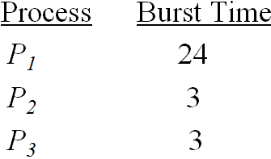
FCFS Scheduling
Suppose that the processes arrive in the order: P₁ ,P₂ , P₃ The Gantt Chart for the schedule is:
P₁
P₂
P₃
0
24
27
30
  Waiting time for P₁ = 0; P₂ = 24; P₃ = 27
  Average waiting time: (0 + 24 + 27)/3 = 17

Slide 29
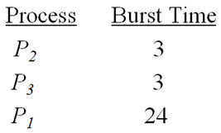
FCFS Scheduling
Suppose that the processes arrive in the order
P₂ , P₃ , P₁ .The Gantt chart for the schedule is:
P₂
P₃
P₁
0
3
6
30
  Waiting time for P1 = 6; P2 = 0; P3 = 3
  Average waiting time: (6 + 0 + 3)/3 = 3
  Much better than previous case.

Slide 30
FCFS Scheduling
Convoy effect (护航效果) : short process behind long process and waiting for a long time.（上例第一种情况）
The FCFS scheduling algorithm is nonpreemptive.
The FCFS algorithm is particularly troublesome for time-sharing systems.
  It would be disastrous to allow one process to keep the CPU for an extended period.

Slide 31
Scheduling Algorithms
  FCFS (First-Come, First-Served ) （先到先行调度）
  SJF (Shortest-Job-First )（最短作业优先调度）
  Priority Scheduling（优先级调度）
  RR (Round Robin ) （轮转法调度）
  Multilevel Queue（多级队列调度）

Slide 32
SJF Scheduling
Definition
Schemes
Example

Slide 33
SJF Scheduling
Definition
Schemes
Example

Slide 34
SJF Scheduling
Definition
  Associate with each process the length of its next CPU burst. Use these lengths to schedule the process with the shortest time.
  SJF is optimal – gives minimum average waiting time for a given set of processes

Slide 35
SJF Scheduling
Definition
Schemes
Example

Slide 36
SJF Scheduling
Two schemes:
  Nonpreemptive
  once CPU given to the process it cannot be preempted until completes its CPU burst.
  Preemptive
  if a new process arrives with CPU burst length less than remaining time of current executing process, preempt. This scheme is know as the
  Shortest-Remaining-Time-First (SRTF最短剩余时间优先).

Slide 37
SJF Scheduling
Definition
Schemes
Example

Slide 38
SJF Scheduling
Example of Non-Preemptive SJF
Process Arrival Time Burst Time
P₁ 0.0 7
P₂ 2.0 4
P₃ 4.0 1
P₄ 5.0 4

Slide 39
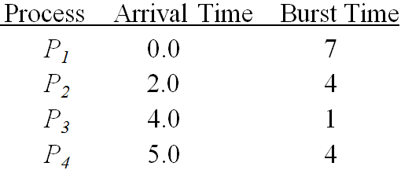
SJF Scheduling
The Gantt chart for the schedule is
P₁
P₃
P₂
P₄
0
3
7
8
12
16
Average waiting time
= (0 + 6 + 3 + 7)/4 = 4

Slide 40
SJF Scheduling
Example of Preemptive SJF
Process Arrival Time Burst Time
P₁ 0.0 7
P₂ 2.0 4
P₃ 4.0 1
P₄ 5.0 4

Slide 41
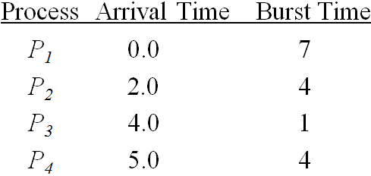
SJF Scheduling
  The Gantt chart for the schedule is
  Average waiting time
  = (9 + 1 + 0 +2)/4 = 3
P₁
P₂
P₃
P₂
P₄
P₁
0
2
4
5
7
11
16

Slide 42
SJF Scheduling
  The SJF scheduling algorithm is provably optimal.
  The SJF scheduling algorithm supports both preemptive and non-preemptive scheduling algorithms.
  Suitable for long-term scheduling(作业调度).
  Not very good for short-term scheduling(CPU调度).
  Difficult to estimate the CPU bursts.

Slide 43
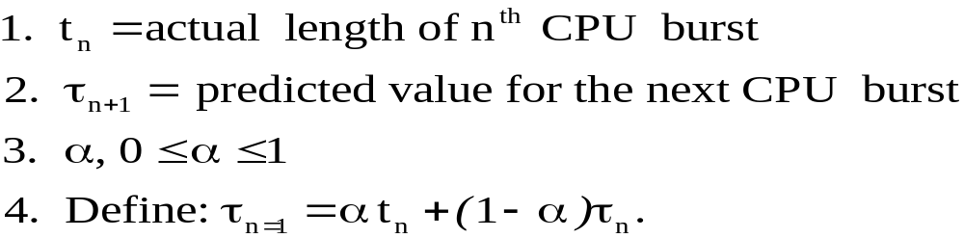




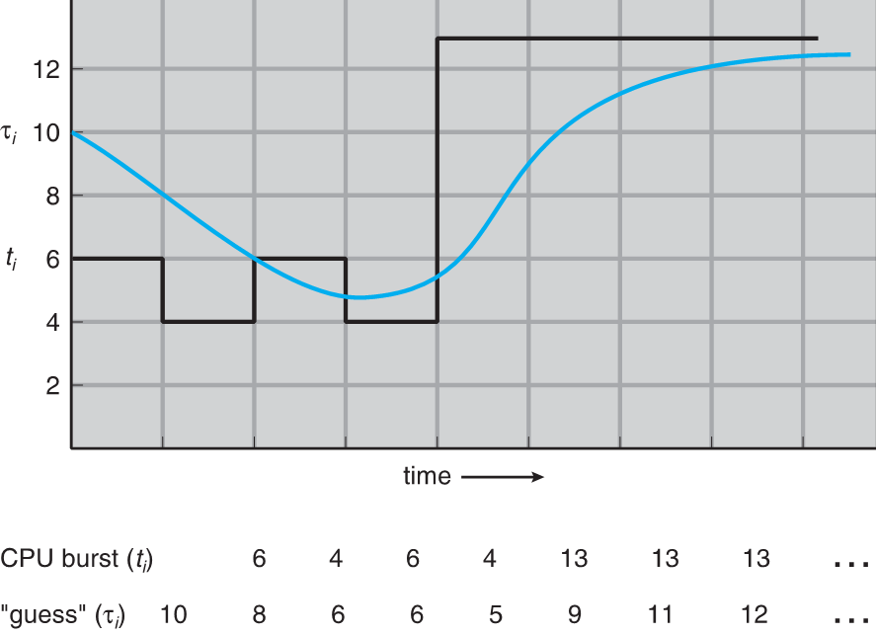
预测CPU时间
预测值 ：由最近值 和历史预测值 通过调整权值
决定。

Slide 44
Scheduling Algorithms
  FCFS (First-Come, First-Served ) （先到先行调度）
  SJF (Shortest-Job-First )（最短作业优先调度）
  Priority Scheduling（优先级调度）
  RR (Round Robin ) （轮转法调度）
  Multilevel Queue（多级队列调度）

Slide 45
Priority Scheduling
A priority number (integer) is associated with each process
The CPU is allocated to the process with the highest priority
(smallest integer ≡ highest priority).
  Preemptive
  nonpreemptive

Slide 46
Priority Scheduling
SJF is a priority scheduling where priority is the predicted next CPU burst time.
Problem：Starvation(饥饿) – low priority processes may never execute.
Solution：Aging(老化) – A process will increase its priority with time.
优先级是可以改的

Slide 47
Priority Scheduling
Process Burst Time Priority
P1 10 3
P2 1 1
P3 2 4
P4 1 5
P5 5 2
本课程设定：数值越小优先级越大

Slide 48
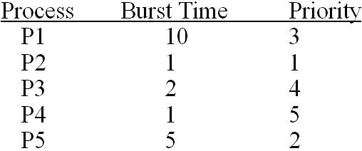

Priority Scheduling
  Priority scheduling
抢占式？
到来时间
0.0
2.0
5.0
9.0
13.0
自行讨论
  Waiting time: (6+0+16+18+1)/5 =8.2.

Slide 49
Scheduling Algorithms
  FCFS (First-Come, First-Served ) （先到先行调度）
  SJF (Shortest-Job-First )（最短作业优先调度）
  Priority Scheduling（优先级调度）
  RR (Round Robin ) （轮转法调度）
  Multilevel Queue（多级队列调度）

Slide 50
Round Robin (RR)
Definition
Performance
Example

Slide 51
Round Robin (RR)
Definition
Performance
Example

Slide 52
Round Robin (RR)
Definition
  Each process gets a small unit of CPU time (time quantum&time slice), usually 10-100 milliseconds. After this time has elapsed, the process is preempted and added to the end of the ready queue.
  If there are n processes in the ready queue and the time quantum is q, then each process gets 1/n of the CPU time in chunks of at most q time units at once.
  No process waits more than (n-1)q time units.

Slide 53

Round Robin (RR)
切换是有开销的！会增加进程的周转时间。
时间片长度定多少合适？效率和公平如何两全？

Slide 54
Round Robin (RR)
Definition
Performance
Example

Slide 55
Round Robin (RR)
Performance
  q large ⇒ FCFS
  q small ⇒ q must be large with respect to context switch, otherwise overhead is too high.

Slide 56
Round Robin (RR)
Definition
Performance
Example

Slide 57
Round Robin (RR)
Example
Process Burst Time
P₁ 53
P₂ 17
P₃ 68
P₄ 24

Slide 58
Round Robin (RR)
The Gantt chart is:
Quantum = 20
平均等待时间＝？
Typically, higher average turnaround than SJF, but better response.（比SJF有更长的周转时间和更小的响应时间）
P₁
P₂
P₃
P₄
P₁
P₃
P₄
P₁
P₃
P₃
0
20
37
57
77
97
117
121
134
154
162
Quantum = 40？

Slide 59
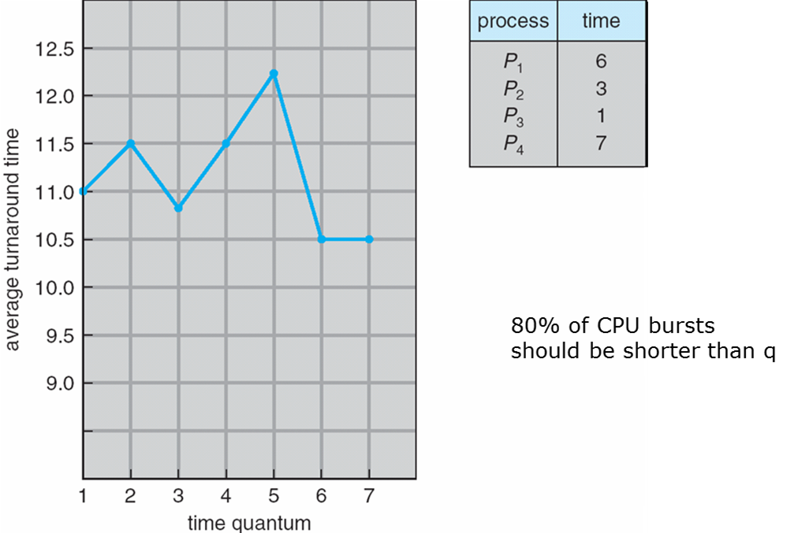
Round Robin (RR)
周转时间随时间片大小变化图例

Slide 60
Scheduling Algorithms
  FCFS (First-Come, First-Served ) （先到先行调度）
  SJF (Shortest-Job-First )（最短作业优先调度）
  Priority Scheduling（优先级调度）
  RR (Round Robin ) （轮转法调度）
  Multilevel Queue（多级队列调度）

Slide 61
Multilevel Queue
Definition
Multilevel Queue Scheduling
Multilevel Feedback Queue

Slide 62
Multilevel Queue
Definition
Multilevel Queue Scheduling
Multilevel Feedback Queue

Slide 63
Multilevel Queue
Definition
  Ready queue is partitioned into separate
  queues:
    foreground (interactive) --前台（交互式）
    background (batch) -- 后台（批处理）
  Each queue has its own scheduling algorithm,
    foreground – i.e.RR
    background – i.e.FCFS

Slide 64
Multilevel Queue
Definition
Multilevel Queue Scheduling
Multilevel Feedback Queue

Slide 65
Multilevel Queue
Scheduling must be done between the queues.
  Fixed priority scheduling; i.e., serve all from foreground then from background. Possibility of starvation.
  Time slice – each queue gets a certain amount of CPU time which it can schedule amongst its processes; i.e.,80% to foreground in RR,20% to background in FCFS

Slide 66

Multilevel Queue Scheduling

Slide 67
Multilevel Queue
Definition
Multilevel Queue Scheduling
Multilevel Feedback Queue

Slide 68
Multilevel Feedback Queue
A process can move between the various queues; aging can be implemented this way.
Multilevel-feedback-queue scheduler defined by the following parameters:
  number of queues.
  scheduling algorithms for each queue.
  method used to determine which queue a process will enter when that process needs service.
  method used to determine when to upgrade/downgrade a process.

Slide 69
Multilevel Feedback Queue
Three queues:
  Q0 – time quantum 8 milliseconds
  Q1 – time quantum 16 milliseconds
  Q2 – FCFS
Scheduling
  A new job enters queue Q0 which is served FCFS. When it gains CPU, job receives 8 milliseconds. If it does not finish in 8 milliseconds, job is moved to queue Q1.
  At Q1, job is again served FCFS and receives 16 additional milliseconds. If it still does not complete, it is preempted and moved to queue Q2.

Slide 70

Multilevel Feedback Queues

Slide 71
Ch 6: CPU Scheduling
Basic Concepts
Scheduling Criteria
Scheduling Algorithms
Multiple-Processor Scheduling
Real-Time Scheduling
Thread Scheduling
Algorithm Evaluation

Slide 72
Multiple-Processor Scheduling
CPU scheduling more complex when multiple
CPUs are available.
Homogeneous processors（同构处理器） within a multiprocessor.
  Symmetric Multiprocessing (SMP) – each processor makes its own scheduling decisions.
  Asymmetric multiprocessing – only one processor accesses the system data structures, alleviating the need for data sharing.
！
哪个难实现？

Slide 73
Multiple-Processor Scheduling
Processor affinity（亲和性） – process has affinity for processor on which it is currently running
  soft affinity
  hard affinity
  Variations including processor sets（处理器子集）
尽量避免进程在不同处理器之间迁移

Slide 74
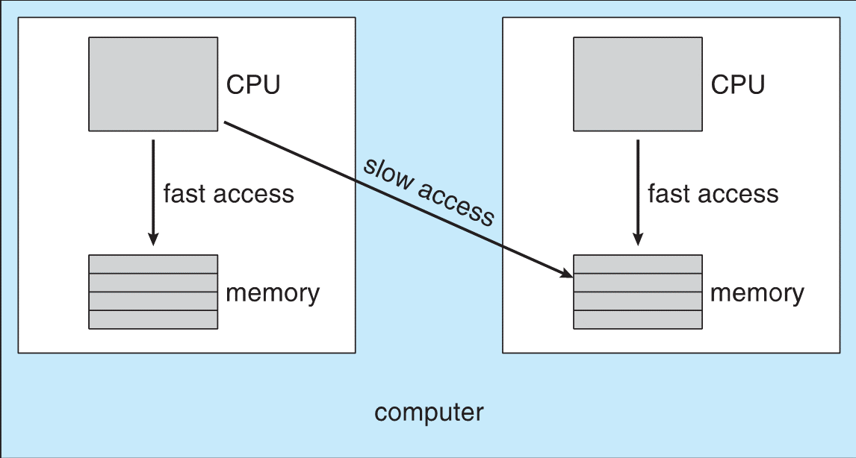
Multiple-Processor Scheduling
NUMA与CPU调度
NUMA：Non-Uniform Memory Access非一致性内存访问

Slide 75
Load Balancing 负载均衡
If SMP, need to keep all CPUs loaded for efficiency
Load balancing attempts to keep workload evenly distributed
  Push migration （推迁移）– periodic task checks load on each processor, and if found pushes task from overloaded CPU to other CPUs --- 忙转闲
  Pull migration（拉迁移） – idle processors pulls waiting task from busy processor --- 闲转忙
保持亲和性如何和负载均衡折中

Slide 76
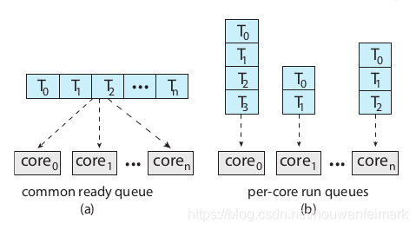
Multicore-Processor（多核处理器）
（a）共用调度队列，面临队列的锁机制
（b）更通用，但面临负载均衡问题

Slide 77
Multicore-Processor（多核处理器）
内存停顿：当处理器执行代码需要访问主存时，
因为访问主存很慢，导致会浪费很多
cpu周期。
解决办法：芯片多线程技术(CMT)，例如Intel的
超线程，如i5双核四线程，就是每个
核有两个hardware thread。这样可以在
一个线程停顿时快速切换到另一个线
程。
memory stall

Slide 78

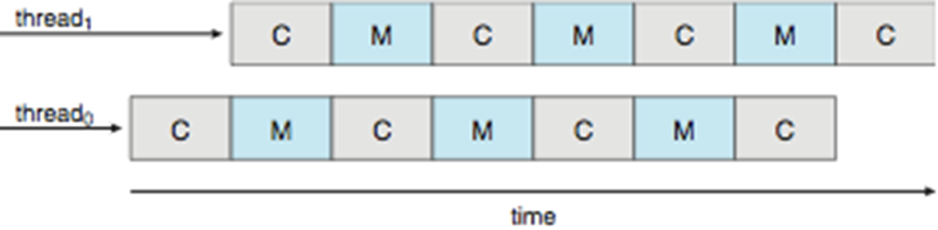
Multicore-Processor（多核处理器）
内存停顿
超线程

Slide 79
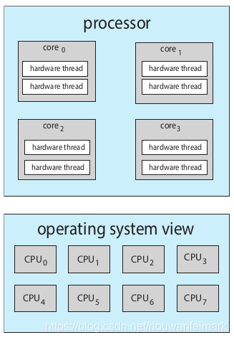
Multicore-Processor（多核处理器）
超线程

Slide 80
Ch 6: CPU Scheduling
Basic Concepts
Scheduling Criteria
Scheduling Algorithms
Multiple-Processor Scheduling
Real-Time Scheduling
Thread Scheduling
Algorithm Evaluation

Slide 81
Real-Time Scheduling
  Hard real-time systems --required to complete a critical task within a guaranteed amount of time.
  Hard real-time systems are composed of special-purpose software running on hardware dedicated to their critical process, and lack the full functionality of modern computers and operating systems.
Soft real-time computing --requires that critical processes receive priority over less fortunate ones.
  Priority scheduling
  Low dispatch latency（降低分派延迟）
    To insert preemption points(抢占点).
    To make the entire kernel preemptible.
    To support priority inversion(优先级倒置)：用优先级继承解决

Slide 82
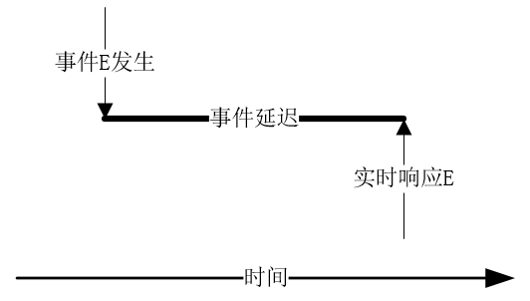
Real-Time Scheduling
事件延迟
中断延时和分派延时会影响事件延迟

Slide 83
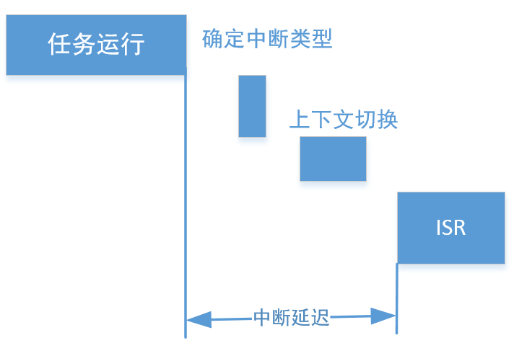
Real-Time Scheduling
中断延迟

Slide 84
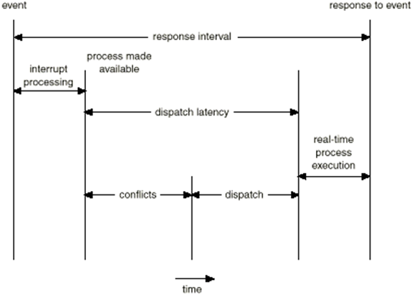
Real-Time Scheduling
响应间隔
分派延迟
第一阶段：抢占低优先级进程
第二阶段：分配资源给高优先级进程
分派延迟组成

Slide 85
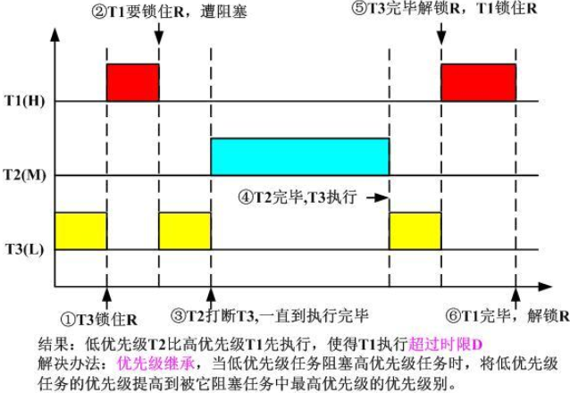
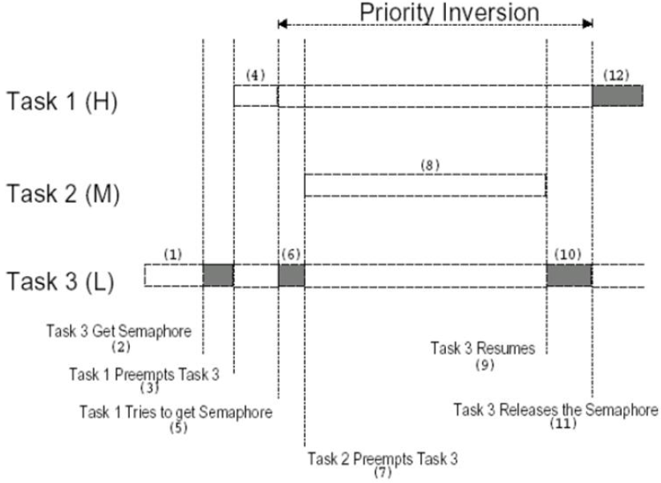
Real-Time Scheduling

Slide 86
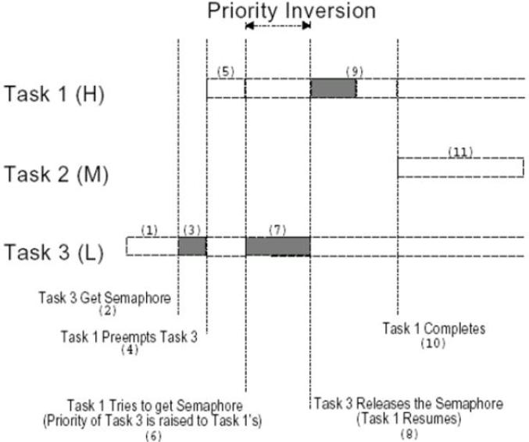
Real-Time Scheduling
优先级继承后

Slide 87

常用的实时调度算法
参数介绍
  周期 p
  处理时间 t
  截止时间 d
  0 ≤ t ≤ d ≤ p

Slide 88
常用的实时调度算法
单调速调度RMS(Rate Montonic Scheduling)
  基本假设
    假设调度周期性任务
    假设每个任务进入系统会被分配一个固定优先级，周期越短优先级越高，周期越长优先级越低
    假设任务的deadline是下一次执行前
  不能保证CPU利用率
  它是静态优先级算法中最优的

Slide 89
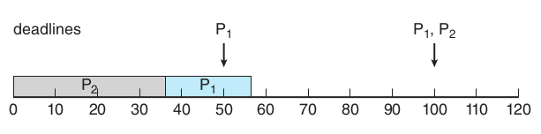
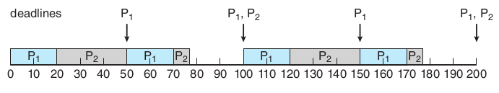
单调速调度RMS
如：P1周期为50，cpu时间为20，P2周期为100，cpu时间为35
1） p2优先级高，先运行，那么p1就无法在deadline50完成
X
2） p1优先级高，先运行
P1抢占P2

Slide 90
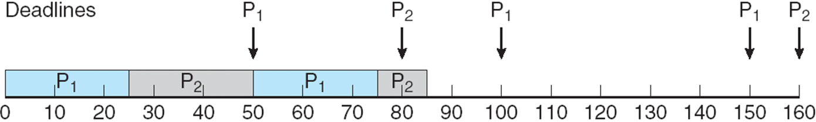
单调速调度RMS失效
如：P1周期为p1=50，cpu时间为25，
P2周期为p2=80，cpu时间为35
X

Slide 91
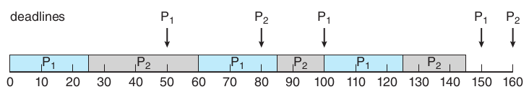
常用的实时调度算法
最早截止期限优先EDF(Earliest Deadline First Scheduling )
根据任务的deadline动态调整进程的优先级。理论上是
最优的算法，既能保证进程满足deadline又能保证cpu有很
好的利用率。
如：P1周期为50，cpu时间为25，P2周期80，cpu时间为35
P1抢占P2

Slide 92
最早截止期限优先EDF
    EDF和RMS比较
    不需要任务是周期性任务
    不需要任务cpu执行时间是常数
    在调度时，要求知道各进程截止期限
    EDF理论上的最优的

Slide 93
常用的实时调度算法
比例分享调度PSS(Proportional Share Scheduling)
按比例分享cpu时间，准入控制器会接收请求，如果有足够的份额则准入，否则会拒绝请求。
如,：总份额100，A需要50、B需要20、C需要15，当新来的D需
要30，则会被拒绝。（100-50-20-15=15）

Slide 94
Ch 6: CPU Scheduling
Basic Concepts
Scheduling Criteria
Scheduling Algorithms
Multiple-Processor Scheduling
Real-Time Scheduling
Thread Scheduling
Algorithm Evaluation

Slide 95
Thread Scheduling
用户级线程与内核级线程的区别
竞争范围
  进程竞争范围process-contention scope (PCS)
适用于多对多、多对一模型
  系统竞争范围system-contention scope (SCS)
适用于一对一模型

Slide 96
Ch 6: CPU Scheduling
Basic Concepts
Scheduling Criteria
Scheduling Algorithms
Multiple-Processor Scheduling
Real-Time Scheduling
Thread Scheduling
Algorithm Evaluation

Slide 97
Algorithm Evaluation
    Deterministic modeling（确定性建模）
    Queueing models（排队模型）
    Simulations（模拟）
    Implementation （实现）

Slide 98
Algorithm Evaluation
    Deterministic modeling（确定性建模）
    Queueing models（排队模型）
    Simulations（模拟）
    Implementation （实现）

Slide 99
Analytic Evaluation:
Deterministic modeling
Deterministic modeling(确定性建模)
takes a particular predetermined workload and defines the performance of each algorithm for that workload.
  To describe scheduling algorithms and provide examples
  Simple and fast
  But, Too specific to be useful.
假设特例---以点概面

Slide 100
Algorithm Evaluation
    Deterministic modeling（确定性建模）
    Queueing models（排队模型）
    Simulations（模拟）
    Implementation （实现）

Slide 101
Queuing models
Queuing models（排队模型）
  Queueing-network analysis
  The computer system is described as a network of servers.
  Each server has a queue of waiting process.
  Knowing arrival rates and service rates, we can compute utilization, average queue length, average wait time, and so on.
Useful for comparing scheduling algorithms.
Real distributions are difficult to work with.
Some assumptions required.
利用统计学原理，求平均

Slide 102
Algorithm Evaluation
    Deterministic modeling（确定性建模）
    Queueing models（排队模型）
    Simulations（模拟）
    Implementation （实现）

Slide 103
Simulations
Simulations (模拟) involve programming a model of the computer system.
  Software data structures represent the major components of the system.
  The simulator has a variable representing a clock; as this variable ‘s value is increased, the simulator modifies the system to reflect the activities of the device, the processes, and the scheduler.
  As the simulation executes, statistics that indicate algorithm performance are gathered and printed.
Artificial data or trace tapes.
Useful but expensive.

Slide 104

Evaluation of CPU Schedulers by Simulation
需要大量存储空间
大量设计、编码、调试工作

Slide 105
Algorithm Evaluation
    Deterministic modeling（确定性建模）
    Queueing models（排队模型）
    Simulations（模拟）
    Implementation （实现）

Slide 106
Implementation
Implementation (实现)
  To code the algorithm,
  To put it in the OS, and
  To see how it works.
Costly.
A Perfect Scheduling Algorithm Is Not Easy To Found.

Slide 107
小结
调度概念
几种CPU调度算法

